Slide 1
Computer Hardware
Definitions
The Computer System
Parts of the computer system
What makes up the system unit
Storage devices
How to connect the different peripherals together?
Booting
Memory
Input devices
Output Devices

Slide 2
A Computer-definition
A computer is an electronic device that processes data according to instructions provided by software programs. It takes input (data), processes it using a central processing unit (CPU), stores information, and produces output (results) to perform various tasks.
A Computer an electronic programmable device that capable of accepting instructions(input/data), stores instructions in memory processes data , stores information and outputs the results.

Slide 3
A computer is a programmable machine that accepts input, processes it according to a set of stored instructions (a program), and produces output, all while capable of storing and retrieving data.
A computer is an electronic device, operating under the control of instructions stored in its own memory that can accept data (input), process the data according to specified rules, produce information (output), and store the information for future use

Slide 4
Functionalities of A Computer
Any digital computer carries out five basic functions.
Input: Take data as input
Storage: Stores the data/instructions in its memory and uses them when required
Processing: Processes the data and converts it into information
Output: Generates the output
Control: Controls all the above functions.

Slide 5
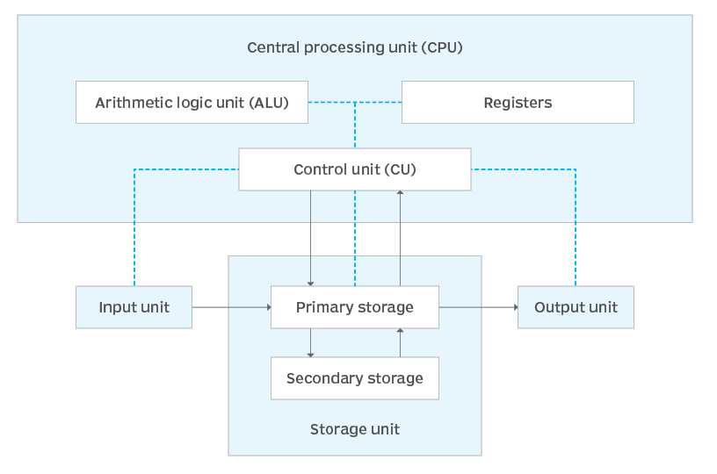
A computer system
A computer system is a complex configuration composed of hardware, software, and additional equipment designed to work in synchrony to facilitate data processing. The system is characterized by an input component, a processing unit, and an output component.
A computer system consists of hardware components that have been carefully chosen so that they work well together and software components or programs that run in the computer.

Slide 6
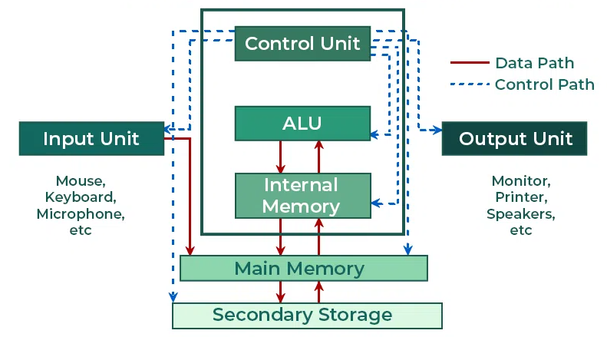
Components of a computer system
The components of a computer system are typically divided into hardware and software parts, which are both essential in making a computer system functional.
Functional Components of Computer.

Slide 7
Hardware components
The hardware components include the computer itself; the physical parts inside the computer, such as a circuit board and storage devices; and any peripherals attached to the computer. These components can be either classified as input devices, such as a mouse or keyboard, or output devices, such as a monitor or a printer. While output devices reflect or display user data, input devices are designed to accept user data.

Slide 8
Input Unit
These are devices used to capture data and instructions from users or external sources and convert user input into binary signals that the computer can process.
Common Devices (2025):
  Keyboard, Mouse, Touchscreens
  Scanners, Sensors, Stylus pens
  Voice Assistants (e.g., Siri, Alexa)
  Biometric devices (face/fingerprint recognition)
  Iot-based inputs from smart devices

Slide 9
Central Processing Unit (CPU) – The Brain of the Computer
The CPU executes instructions and controls all internal operations. In 2025, CPUs will often have multiple cores and threads to handle parallel processing efficiently.
Components of CPU:

Slide 10
Arithmetic Logic Unit (ALU)
ALU is a digital circuit that provides arithmetic and logic operations.
Performs arithmetic operations (add, subtract, multiply, divide).
Handles logical operations (comparison, decision-making).
Supports AI/ML tasks using built-in vector/matrix operations (in modern CPUs).

Slide 11
b. Control Unit (CU)
The Control Unit (CU) is a vital component of the CPU, directing the processor's operations and coordinating instruction execution.
The Control Unit (CU) is the part of the CPU that directs and coordinates all operations within the computer, fetching instructions from memory, decoding them, and generating control signals that tell the arithmetic logic unit (ALU), memory, and input/output devices what to do.
Key-functions.
Directs the operations of all computer parts.
Decodes instructions and coordinates data flow.
Sends control signals to memory and I/O devices.

Slide 12
c. Registers
CPU registers are high-speed memory units essential for efficient program execution, enabling quick access to frequently used values.
A CPU register is a small and temporary storage containing a set of data holding places that are part of the computer processor
High-speed memory locations within the CPU.
Temporarily store instructions, addresses, and intermediate data.
Examples: Accumulator, Instruction Register, Program Counter, Address Register.
Modern CPUs include 64-bit or even 128-bit registers for faster processing.

Slide 13
Memory / Storage Unit
The Memory Unit (MU) is a critical component of a computer system, responsible for storing data and instructions required for processing.
The memory unit holds data and instructions before, during, and after processing.
a. Primary Memory (Main Memory):
Primary storage, located on the system board, is the computer component that stores the programs, data and instructions that are in active use by that computer.
RAM (Random Access Memory): Temporarily stores data during execution.
ROM (Read-Only Memory): Stores boot-up instructions and firmware.
Cache Memory: Ultra-fast memory between CPU and RAM (L1, L2, L3 levels).

Slide 14
b. Secondary Storage:
Secondary storage is non-volatile memory used for the long-term, persistent storage of programs and files, retaining data even when the computer is powered off
Used for long-term data storage.
Examples: SSDs (NVMe drives), HDDs, flash drives, and cloud storage.
Modern Trend: Use of Cloud Integration and hybrid storage models.

Slide 15
4. Output Unit
Converts processed data (binary) into a form users can understand.
Examples:
  Visual: Monitors (LED, OLED, 4K/8K displays)
  Print: Printers (Inkjet, Laser, 3D Printers)
  Audio: Speakers, Headphones
  Haptic: Vibration feedback devices
Emerging Tech: AR/VR headsets, voice-based output, Braille displays for accessibility

Slide 16
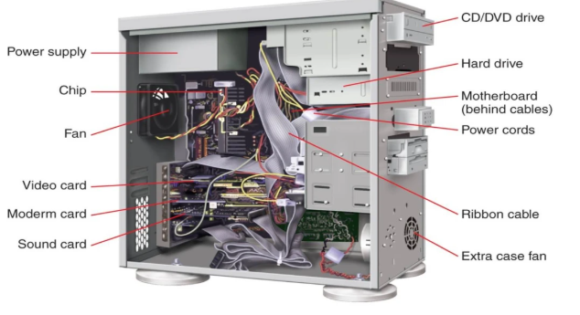
System Unit
The system unit is a box-like case that holds the computer’s internal hardware. It ensures all the components are securely connected and protected from external elements. These internal components include critical parts like the motherboard, CPU, memory, and storage devices, that facilitate the computer to carry out different activities efficiently.

Slide 17
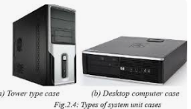
What makes up the system unit
A system unit, in the context of computing, refers to the main part of a personal computer. It's typically a rectangular box that contains important parts like the motherboard, central processing unit (CPU), random access memory (RAM), and storage drives.
The types of system units include towers (tall boxes), desktops (short boxes), and "pizza boxes" (very short boxes). Other types are also sold, or can be custom made. Each system unit type can contain a different number of cards

Slide 18
Key Functions of the System Unit
Protection and Housing:
  The system unit protects sensitive electronic components from dust, moisture, and physical damage.
  It organizes all parts compactly and functionally.
Upgrade Support:
  Most modern system units are designed to support upgrades, such as adding more RAM, installing a new graphics card, or increasing storage capacity.
Connectivity:
  The front of the system unit typically features USB ports, audio jacks, and an optical disk drive for easy access.
  The back contains ports for essential peripherals like the monitor, keyboard, mouse, and internet connection.

Slide 19
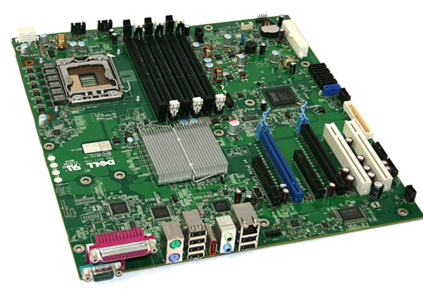
Major Components of the System Unit
The Computer Motherboard.
The motherboard is the backbone of the computer, often called the system board or mainboard. It is a large printed circuit board that connects and supports various components, including: CPU, Memory, Expansion slots, BIOS, and peripheral controllers

Slide 20
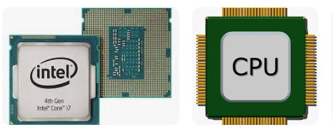
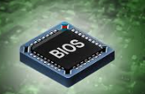
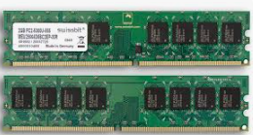
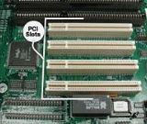
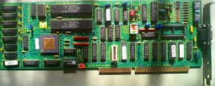
CPU (Central Processing Unit): The ‘brain of the computer‘, responsible for executing instructions.
BIOS (Basic Input/Output System): The firmware that initializes hardware during boot-up.
Memory (RAM): Temporary storage for data and instructions currently in use.
Expansion Slots: For adding extra cards like graphics or sound cards.
Peripheral Controllers: Manage devices like the keyboard, display screen and storage drives.

Slide 21
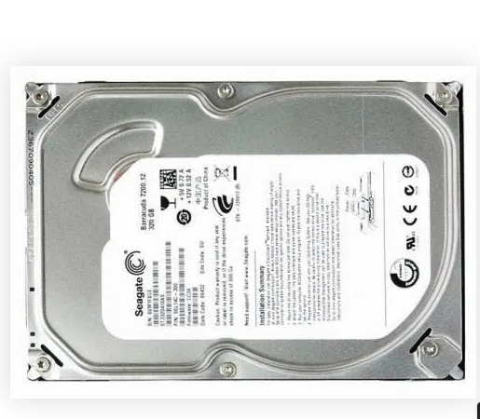
2. Hard Disk Drive (HDD)
The hard disk drive is the primary storage device of the system unit. It stores the operating system, applications, and user data. Some systems may also include removable hard drives for additional storage or data transfer purposes.

Slide 22
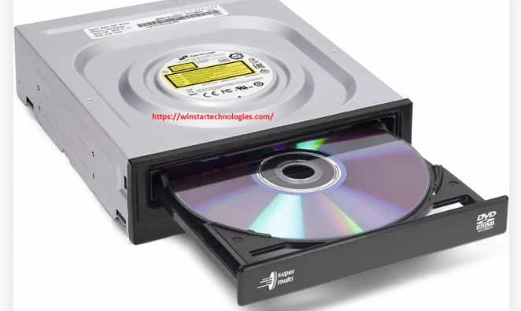
Optical Disk Drive
An optical disk drive (ODD) is used to read and write data on CDs and DVDs. While still present in some desktops, it is becoming less common as cloud storage and USB drives dominate.

Slide 23
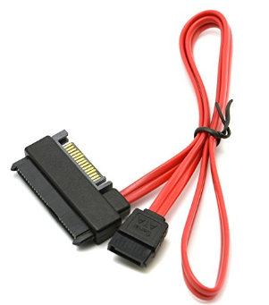
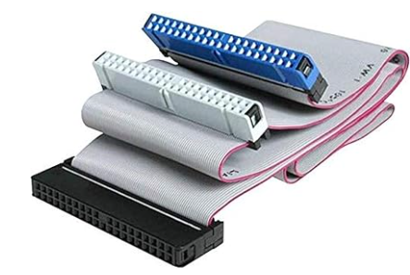
5. Computer Data Cables
These cables transmit data between internal components. Depending on the system, you may encounter SATA cables in modern systems or EIDE cables in older ones.

Slide 24
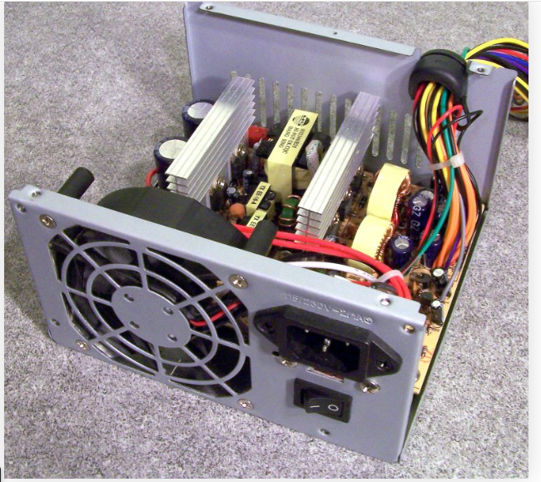
6. Power Supply Unit (PSU)
The power supply unit is vital for converting AC power from a wall socket into the DC power needed by the computer’s components. It also powers connected peripherals, ensuring the smooth operation of the entire system.

Slide 25
Peripheral
A peripheral is a “device that is used to put information into or get information out of the computer.”
A peripheral device is generally defined as any auxiliary device such as a computer mouse or keyboard, that connects to and works with the computer in some way.
There are three different types of peripherals:
Input, used to interact with, or send data to the computer (mouse, keyboards, etc.)
Output, which provides output to the user from the computer (monitors, printers, etc.)
Storage, which stores data processed by the computer (hard drives, flash drives, etc.)

Slide 26
Other examples of peripherals are
expansion cards,
graphics cards,
image scanners,
tape drives, microphones,
loudspeakers,
webcams, and digital cameras
According to the most technical definition, the only pieces of a computer not considered to be peripherals are the central processing unit, power supply, motherboard, and computer case.
Usually, the word peripheral is used to refer to a device external to the computer case, like a scanner,

Slide 27
Common Peripherals
Input Keyboard, Computer mouse, Graphic tablet, Touchscreen Barcode reader, Image scanner Microphone, Webcam, Game controller, Light pen, Scanner Digital camera | Output Computer display Printer Projector Speaker
Input/Output Modem Network interface controller (NIC) | Storage devices Floppy disk drive, Flash drive Disk drive, Smartphone or Tablet computer storage interface CD/DVD drive

Slide 28
Input Devices
In computing, an input device is a peripheral (piece of computer hardware equipment) used to provide data and control signals to an information processing system such as a computer or other information appliance. Examples of input devices include keyboards, mice, scanners, digital cameras and joysticks.

Slide 29
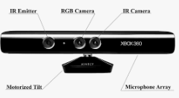
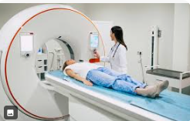
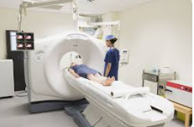
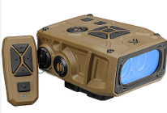
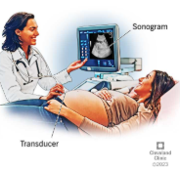

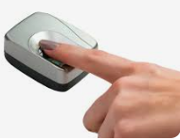
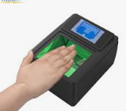
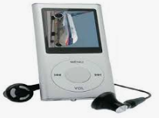

Imaging and video Input Devices
Video input devices are used to digitize images or video from the outside world into the computer. The information can be stored in a multitude of formats depending on the user’s requirement.
Digital camera,
Digital camcorder
Portable media player
Webcam
Microsoft Kinect Sensor
Image scanner
Fingerprint scanner
Barcode reader
3D scanner
Laser rangefinder
Eye gaze tracker
Medical Imaging
Computed tomography
Magnetic resonance imaging
Positron emission tomography
Medical ultrasonography

Slide 30
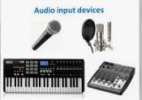
Audio Input Devices
Audio input devices are used to capture sound. In some cases, an audio output device can be used as an input device, in order to capture produced sound.
Microphones
MIDI keyboard or other digital musical instrument

Slide 31
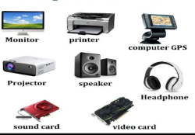
Output Devices
An output device is any piece of computer hardware equipment used to communicate the results of data processing carried out by an information processing system (such as a computer) which converts the electronically generated information into human-readable form.
Display Devices
A display device is an output device that visually conveys text, graphics, and video information. Information shown on a display device is called soft copybecause the information exists electronically and is displayed for a temporary period of time. Display devices include CRT monitors, LCD monitors and displays, gas plasma monitors, and television

Slide 32
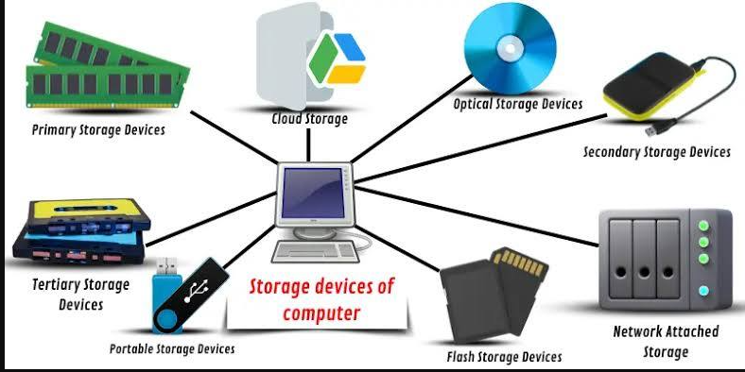
Storage Device
The storage unit is a part of the computer system which is employed to store the information and instructions to be processed. A storage device is an integral part of the computer hardware which stores information/data to process the result of any computational work. Without a storage device, a computer would not be able to run or even boot up. Or in other words, we can say that a storage device is hardware that is used for storing, porting, or extracting data files. It can also store information/data both temporarily and permanently

Slide 33
(a)Explain the functions of any 10 of the following
  Input devices
  Output devices
  Storage devices
(b) Define the term booting
(c)Explain any two types of booting
(d)Describe classifications of computer memory

